Slide 1
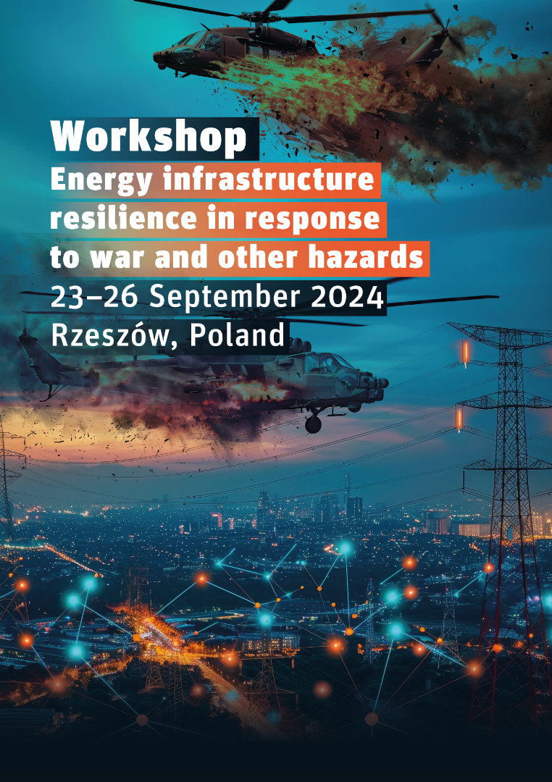

Science for Peace and Security (2024)
Energy infrastructure resilience in response to war and other hazards
Advanced Research Workshop (ARW) supported by NATO
Title
Author(s)
Affiliation
POLAND, Rzeszów, xx.09.2024

Slide 2
Energy infrastructure resilience in response to war and other hazards – Workshop, 23-26 September 2024, Rzeszów, Poland
Author(s)
Title

